Slide 1
TWITTER SENTIMENT ANALYSIS
(Text Analysis and prediction using Python Libraries)

Slide 2
AGENDA
Business Problem and Stakeholders
Data Source and Structure
Model Building Approach
PREDICTIVE Models, Metrics and Model evaluation
5. Conclusion

Slide 3
1. Business Problem and Stakeholders
Given the growing impact of sentiments expressed on social media across businesses, it is essential to monitor and manage this space for the sustained growth and success of all types of organizations.
The objective of this project is to classify the sentiment as either positive or negative by analysing the text in those tweets. Further and future enhancement of the model will enable Brand Monitoring and Reputation Management, Customer Service Automation, obtaining ideas for future and innovative product development etc.
Primary Stakeholders are all consumer facing businesses who wants to see their business sustained and expanded.

Slide 4
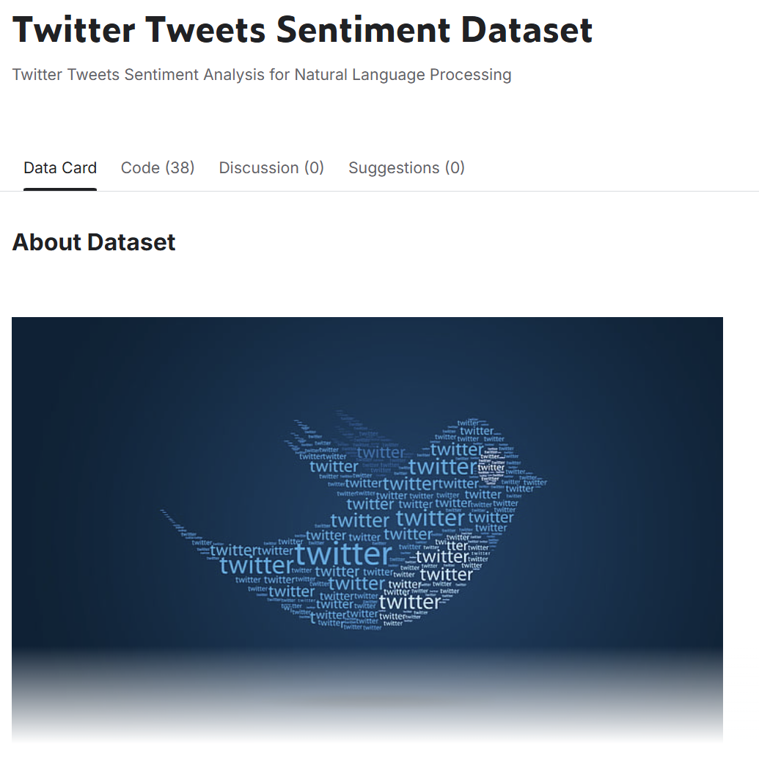
2. Data Source and Structure
Source - Kaggle - Twitter Tweets Sentiment Dataset.

Slide 5
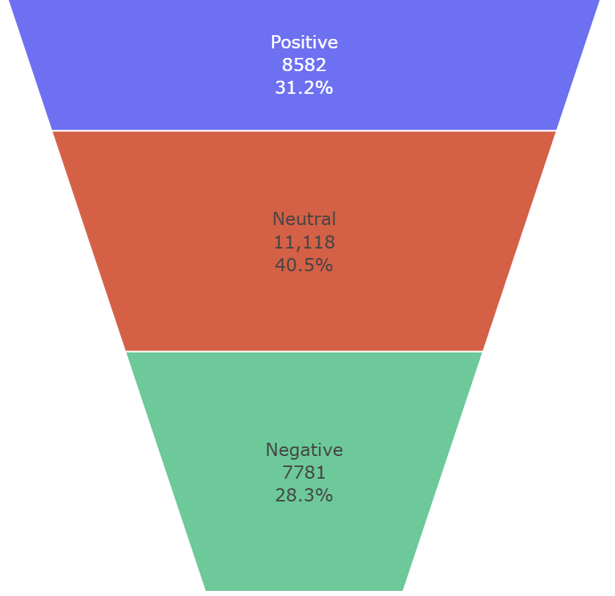
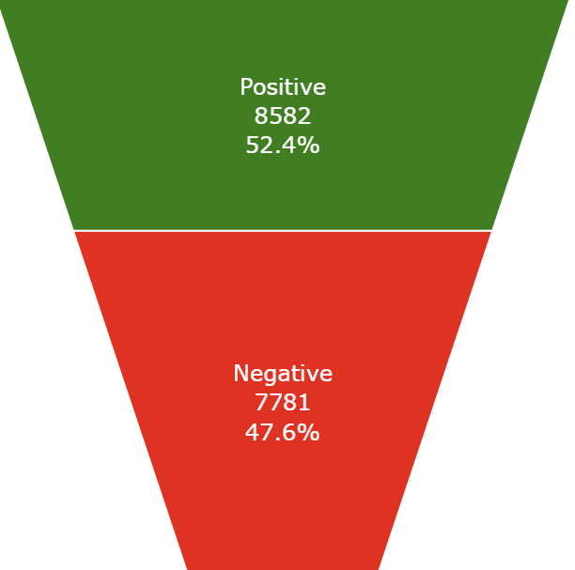
2. Data Source and Structure
Neutral Sentiments are removed and only Positive and Negative views are used for further analysis and building the models

Slide 6
3. Model Building Approach
CountVectorizer
TfidfVectorizer
LogisticRegression
DecisionTreeClassifier
RandomForestClassifier
BaggingClassifier
AdaBoostClassifier
StackingClassifier
PCA
CountVectorizer
TfidfVectorizer
NaiveBayes

Slide 7
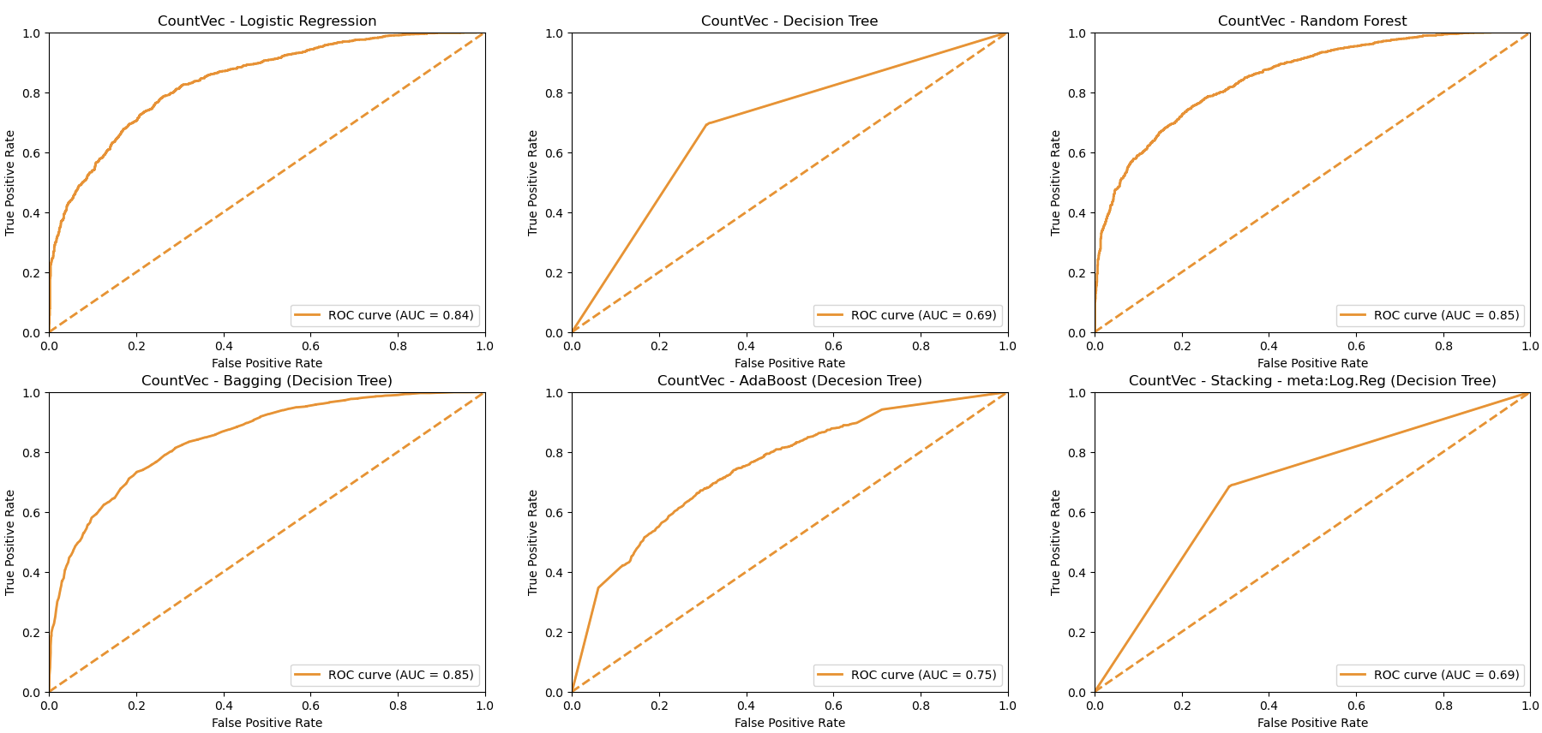
4. PREDICTIVE Models using CountVectorizer - Metrics

Slide 8
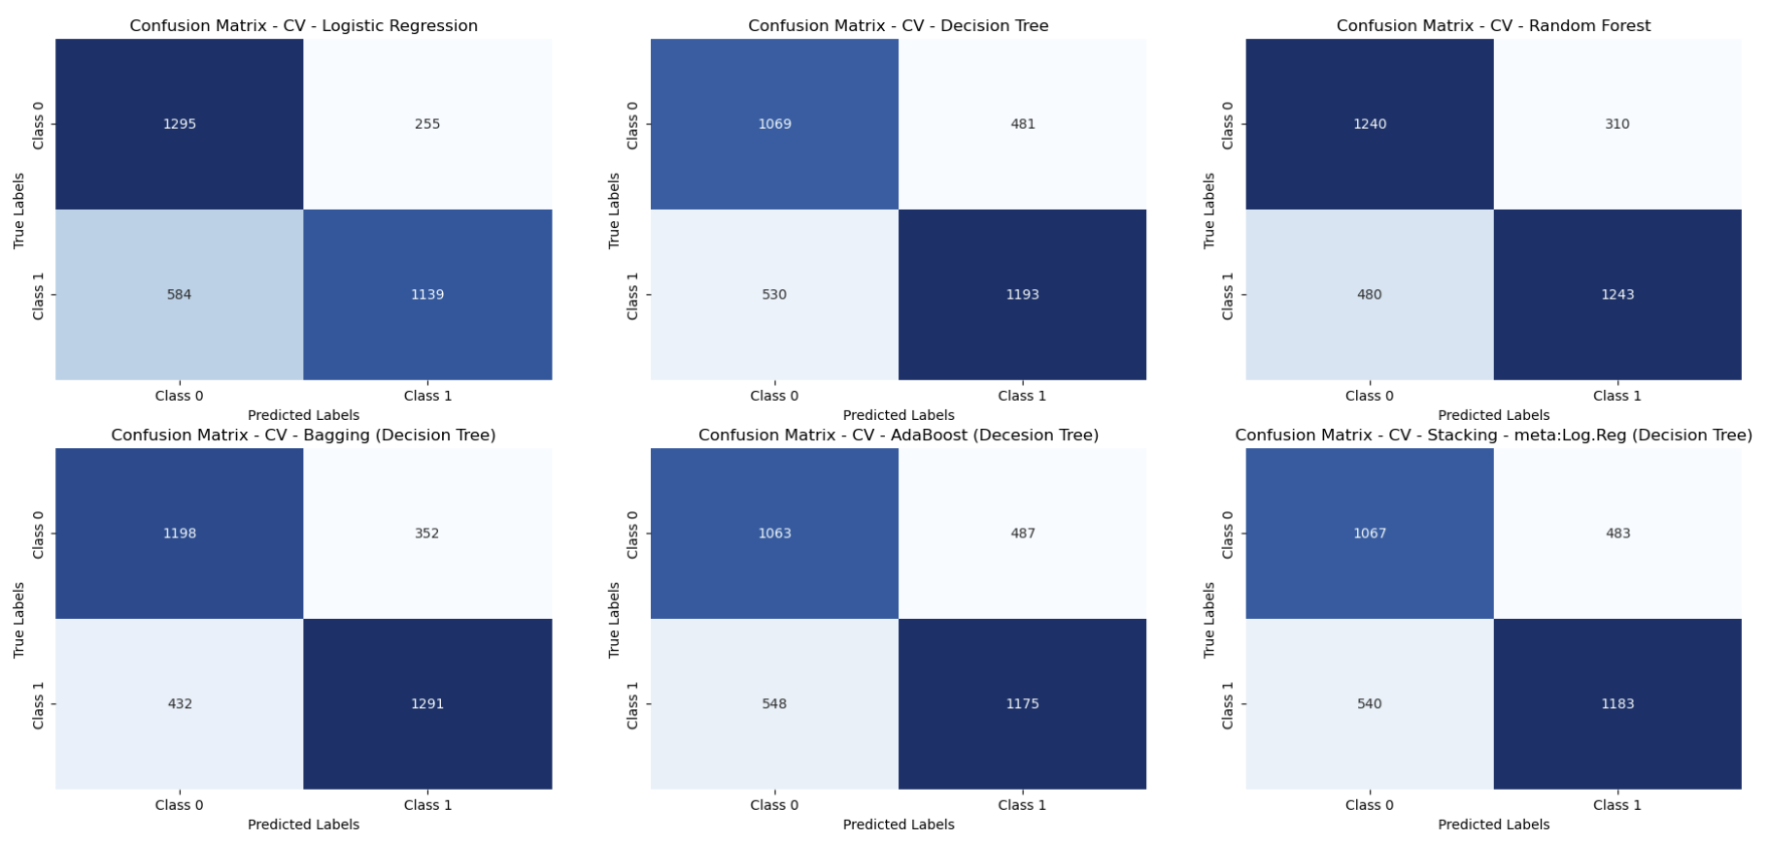
4. PREDICTIVE Models using CountVectorizer - Metrics

Slide 9
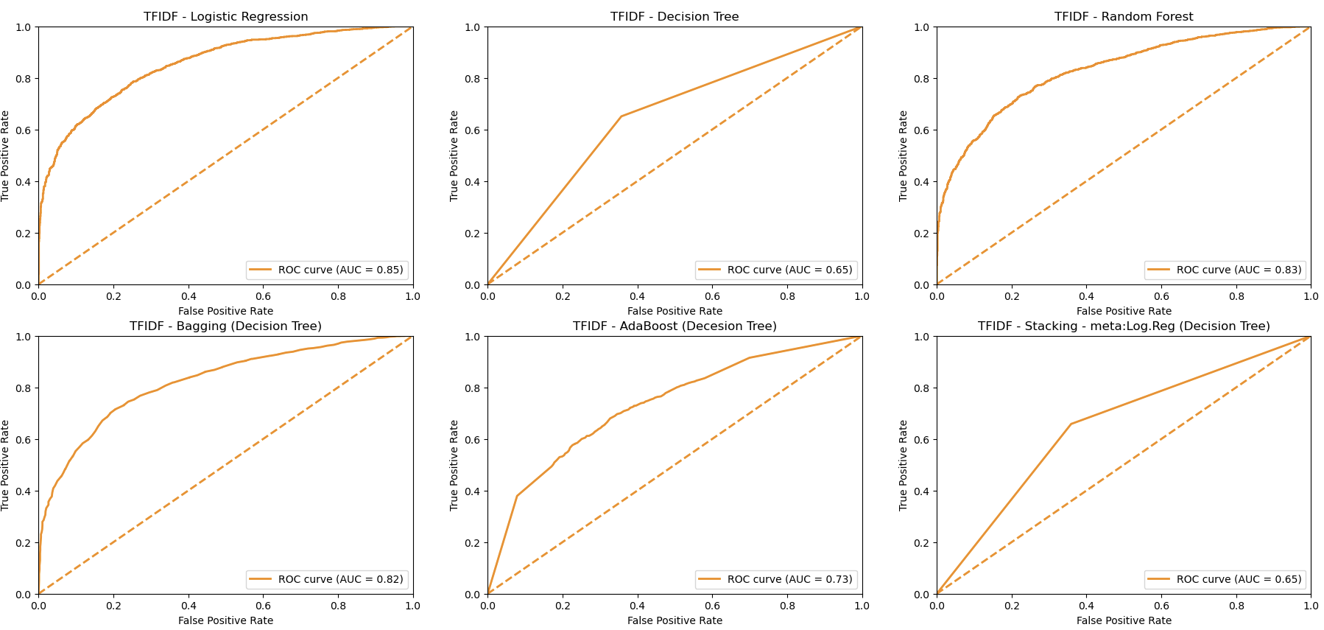
4. PREDICTIVE Models using TfidfVectorizer - Metrics

Slide 10
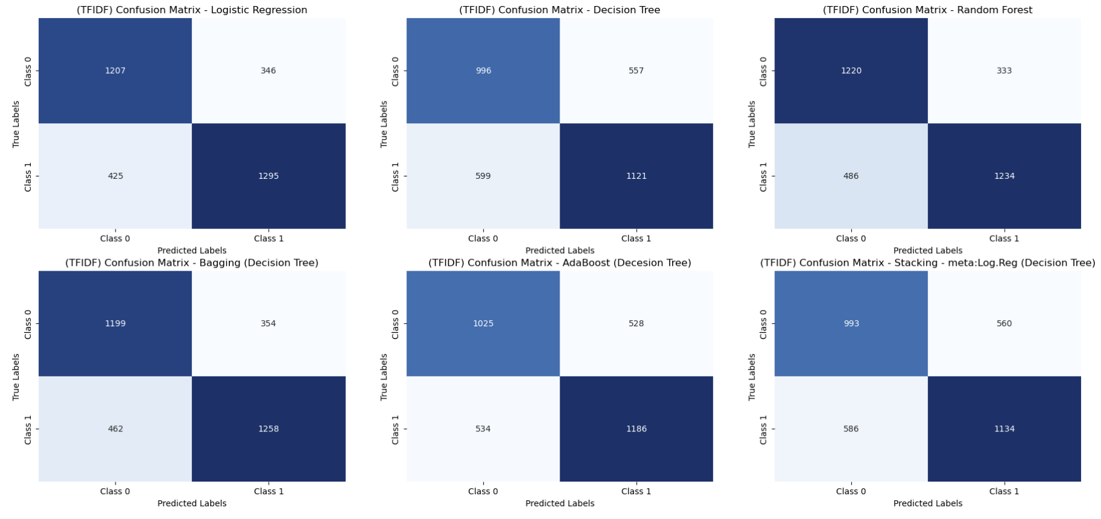
4. PREDICTIVE Models using TfidfVectorizer - Metrics

Slide 11
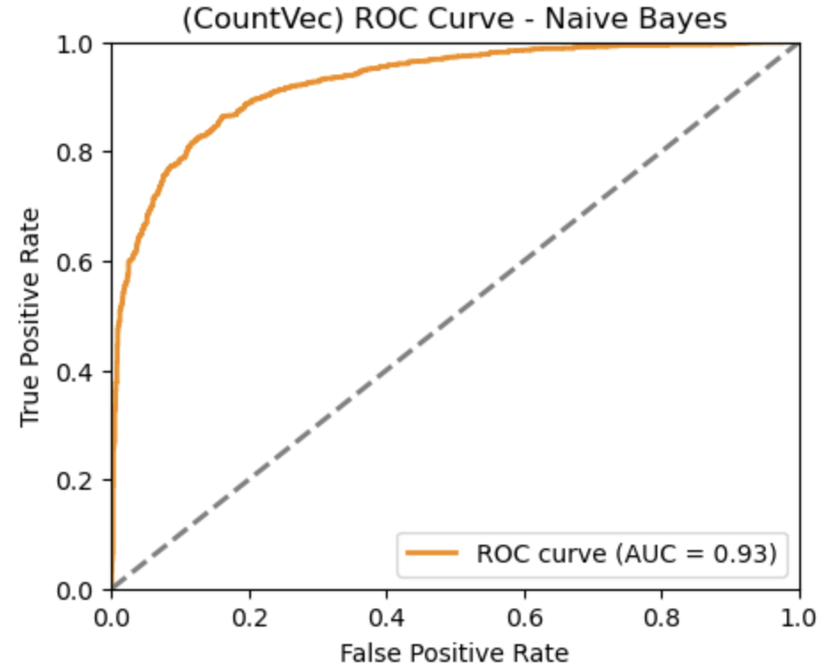
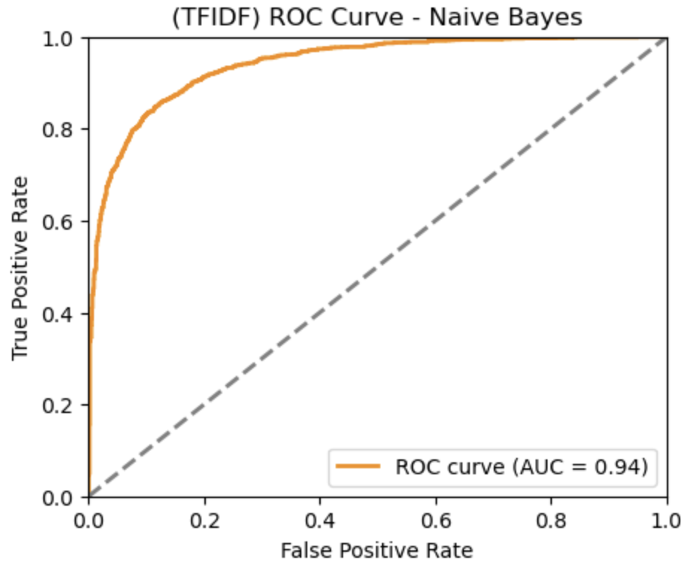
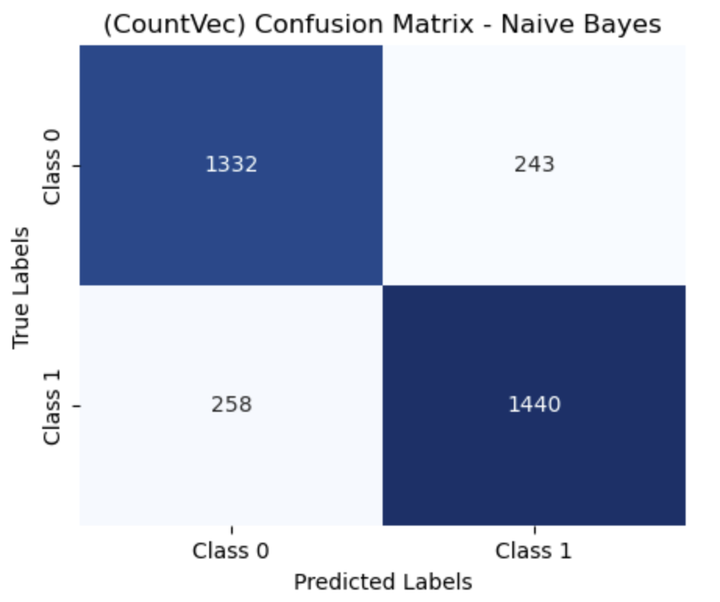
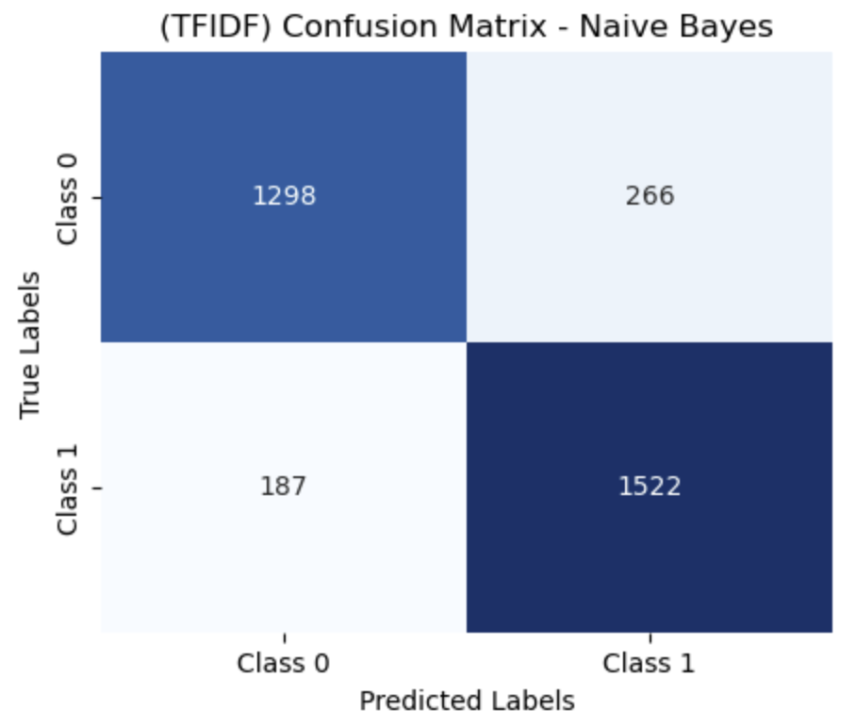
4. PREDICTIVE Models – Naive Bayes

Slide 12
5. Conclusion
Feature reduction using PCA impacts the performance of predictive models whether we use CountVectorizer or TfidfVectoriser. NaiveBayes using full features is delivering the best predictive model and is chosen for classifying the tweets.
The negatively classified comments can be analysed further to extract insights to identify the areas where improvements are required.
The positively classified comments, after further text processing will give insights in to current strengths which is giving the organisation a competitive advantage and should strive to maintain those for continued business success.

